Slide 1
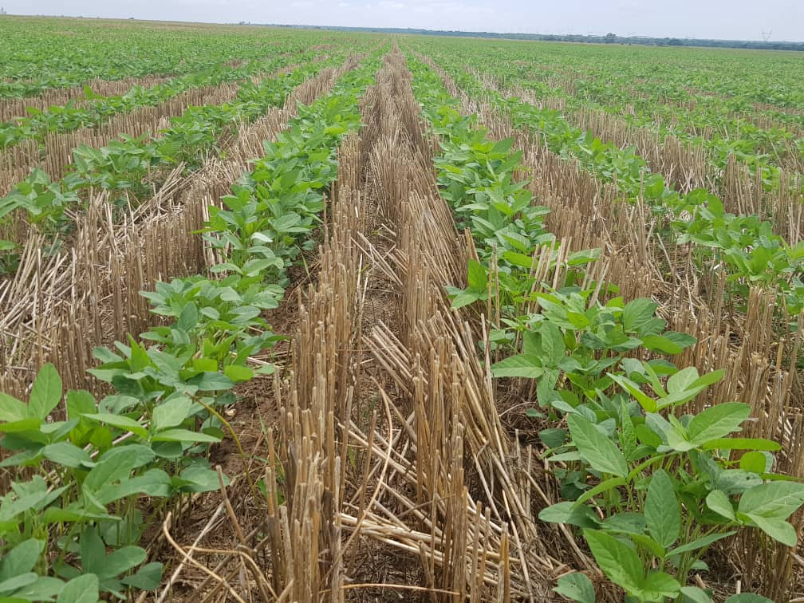
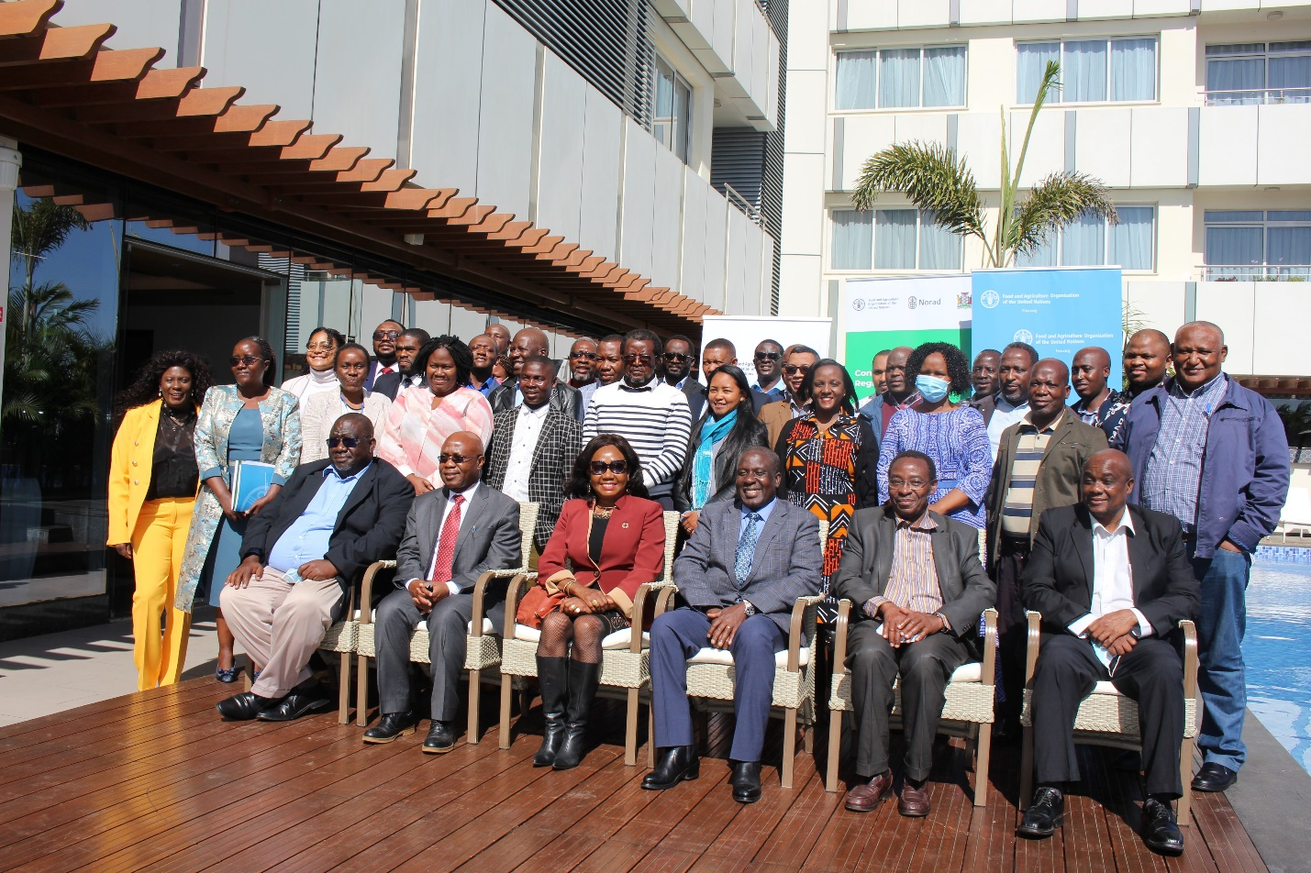
Conservation Agriculture Entry Points into Regional and National Development Frameworks in Southern Africa
Mvumi¹ B, Luchen² S, Mwamakamba³ S, Mashingaidze³ I, Nkanyani³ S, Abang² MM
1University of Zimbabwe, Harare, Zimbabwe
2FAO Sub Regional Office for Southern Africa, South Africa and Zimbabwe
3FANRPAN, Silverton 0127, Pretoria, South Africa
Corresponding author: Sina.Luchen@fao.org
INTRODUCTION
Table 1: CA and CA relevant policies in selected southern African Countries
CA has been successfully implemented to increase resilience to impacts of climate change induced drought and increase yields in southern Africa (Mavesere and Dzawanda, 2022). However, it’s been posited that prospects of the widespread adoption of CA are low if CA adoption fails to translate to tangible benefits for farmers in terms of increased food and income security (Mango et al., 2017). An enabling policy environment is another important determinant of whether CA is adopted and how quickly (Mkomwa et al., 2017).
Country | CA Policy | CA related policies | Relevant National Policies
Eswatini | No | Yes | The Conservation Agriculture Strategy and Action Plan Ministry of Agriculture Strategic Plan (2018-2023) The Swaziland National Investment Plan (SNAIP)
Lesotho | No | Yes | Lesotho Vision 2020 (2004) National Adaptation Programme of Action (NAPA) 2004 Lesotho National Climate Change Policy 2017-2027
Madagascar | No | Yes | The Agriculture, Livestock, Fisheries Sector Program Climate Change Adaptation (PANA) National REDD + strategy Madagascar National Action Plan to Combat Desertification (PANLCD)
Malawi | No | Yes | The National Climate Change Management Policy National Agriculture Policy National Resilience Strategy Malawi Growth and Development Strategy III Malawi 2063
Mozambique | No | Yes | Agriculture Policy and Implementation Strategy Action Plan for Poverty Reduction (PARPA) Green Revolution Strategy (ERV) Action Plan for Food Production (PAPA) Rural Development Strategy (EDR) National Investment Plan for the Agricultural Sector Food and Nutrition Security Strategy (ESAN II) Multi-sectoral Action Plan for the Reduction of Chronic Malnutrition in Mozambique (PAMRDC) 2010-2020
Namibia | No | Yes | Namibia Vision 2030 The Fourth National Development Programme
South Africa | Yes | Yes | The Draft Conservation Agriculture Policy (2017) South Africa National Environmental Management Act 107 of 1998
Tanzania | No | Yes | Agriculture Sector Development Programme phase II (2017/18-2027/28) National Agriculture Climate Resilient Plan (2014-2019)
Zambia | No | Yes | The National Agricultural Investment Programme (NAIP) National climate change response strategy (2010) Vision 2030
As part of its broader programme on CA, the FAO Sub-regional Office for Southern Africa commissioned the Food, Agriculture and Natural Resources Policy Analysis Network (FANRPAN) to map and synthesize CA entry points into regional and national development frameworks..
The study also sought to highlight existing gaps and opportunities for alignment of CA with SDGs, regional and national development frameworks and policies
METHODOLOGY
FANRPAN Nodes in the 10 study countries (Table 1), working with their respective government and FAO CA focal persons, convened national dialogues for relevant stakeholders, including government, policymakers, farmer and civil society organisations, FAO, and NCATFs. The national researchers presented their study findings and recommendations during the meetings for validation by the stakeholders. Most meetings were held virtually, except in Eswatini, Malawi and Namibia, where they were held in person.
The FANRPAN Regional Secretariat convened a Regional CA Dialogue to share the summary of findings and recommendations from the research in the 10 study countries and receive feedback from key regional stakeholders. The feedback from the stakeholders was used to finalise the regional synthesis report and to draft a policy brief based on the research findings and recommendations. The national dialogues and the regional dialogue provided a neutral platform for all stakeholders to deliberate and define CA policy priorities and agree on entry points into regional and national development frameworks in Southern Africa.
At the regional level, both the SADC CAADP Compact/Regional Agricultural Policy (RAP), and the Regional Agricultural Investment Plan (RAIP) cover CA principles. In 2020, the SADC Regional Indicative Strategic Development Plan (RISDP) 2020–2030 was approved.
Zambia and Eswatini target the promotion of CA through their NAIPs
Key interventions to be implemented to achieve this outcome include CA as one of the measures to help farmers adapt to and, where possible, mitigate climate change effects. Other SADC policy frameworks for sustainable agriculture include the Regional Food and Nutrition Security Strategy (2015-2025) and the Industrialisation Strategy and Roadmap (2015-2063).
REFERENCES
Mango N, Siziba S, Makate C. (2017) The impact of adoption of conservation agriculture on smallholder farmers’ food security in semi-arid zones of southern Africa. Agriculture & Food Security 6 (1):1–8.
Mavesere F and Dzawanda, B. (2022) Effectiveness of Pfumvudza as a resilient strategy against drought impacts in rural communities of Zimbabwe. GeoJournal 28: 1–16.
Mkomwa S, Kassam A H, Friedrich T and Shula R K. (2017) Conservation Agriculture in Africa: An overview. In S. Mkomwa, A. H. Kassam, & T. Friedrich, Conservation Agriculture for Africa: Building resilient farming systems in a changing climate (pp. 1-9). London, UK: CABI.
RESULTS
An enabling policy and institutional environment is needed to promote CA.
Countries in Southern Africa generally have policies on agriculture and climate change that promote CA. South Africa is the only country with a CA specific policy (Table 1).
However, CA principles are well covered in government policies and strategies across the 10 countries. For example, Zimbabwe’s National Agriculture Policy Framework 2018-2030, the Climate Policy, and the Climate Change Response Strategy seek to promote climate resilience and sustainable agricultural development.
AKNOWLEDGEMENT
Funding from NORAD for this work is gratefully acknowledged

